Slide 1

Here we go

Slide 2
Changes on Canvas
Access lecture materials

Slide 3




Asking Goods Questions
Notes:
Chapter 12

Slide 4

iClicker Question
Customer intention is a great indicator of future sales. We can just ask customers for their purchase intention to plan ahead.
Agree
Disagree
This Photo by Unknown Author is licensed under CC BY-NC

Slide 5
iClicker Question
Why do we need to implement disguised observation?
To avoid desirability bias
To avoid asking respondents for their consent
Both A and B

Slide 6
iClicker Question
It’s okay to use disguised observation or communication and we don’t need to debrief afterward so that we can collect accurate data without desirability bias.
Agree
Disagree

Slide 7

iClicker Question
What is the trade-off between personal Interview and mail/online survey?
Flexibility vs. interviewer bias
Response rate vs. Cost
Both A and B

Slide 8
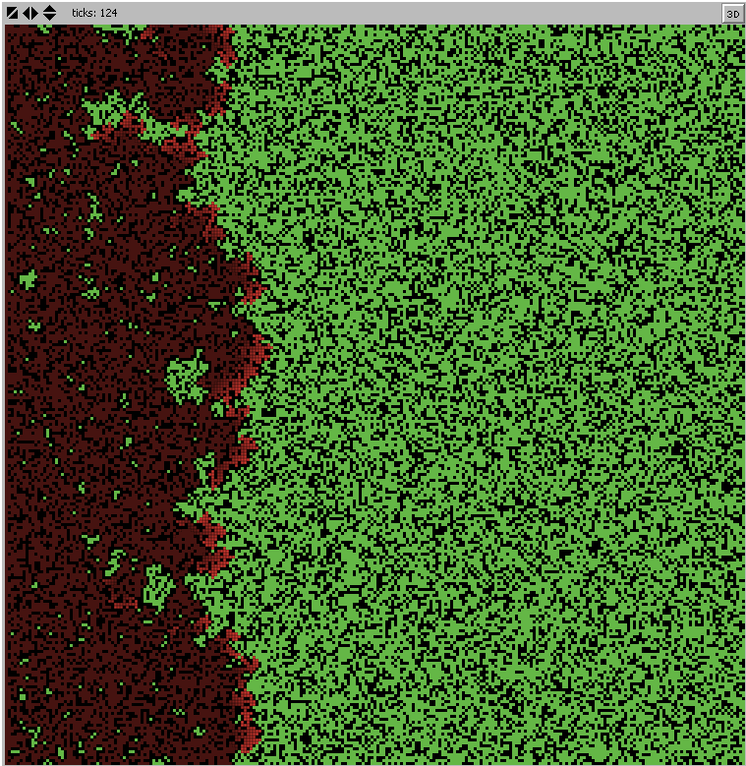
iClicker Question
From the Fire Simulation, we see that it’s bad to have prescribed burning (to reduce density).
TRUE
FALSE

Slide 9

Recap Last Class
Chapter 9: Types of Primary Data
Chapter 10: Observation
Degree of structure
Degree of Disguise
Setting
Method of Administration
Chapter 11: Communication
Degree of Structure
Degree of Disguise
Method of Administration
Notes:
Demographic/socioeconomic characteristics
Personality/lifestyle characteristics
Attitudes
Awareness/knowledge
Intentions
Motivation
Behavior
Degree of structure;: structured vs. unstructured
Degree of Disguise: undisguised vs. Disguised
Setting: natural vs. Contrived
Method of Administration: Human vs. Mechanical
Degree of structure: structured vs. unstructured
Degree of disguise: undisguised vs. disguised
Method of Administration: personal, telephone, mail, and online survey

Slide 10
Learning Objectives
Define the term measurement as it is used in marketing research
List the four scales (levels) of measurement
Name some widely used attitude scaling techniques in marketing research
List some other key decisions to be made when designing scales
Explain the concept of validity as it relates to measuring instruments
Notes:
Chapter 12

Slide 11
Measurement
“rules for assigning numbers to objects in such a way as to represent quantities of attributes” Bennett (1995).
Notes:
Source: Peter D. Bennett, ed., Dictionary of Marketing Terms, 2nd ed. (Chicago: American Marketing Association, 1995), p. 173.

Slide 12
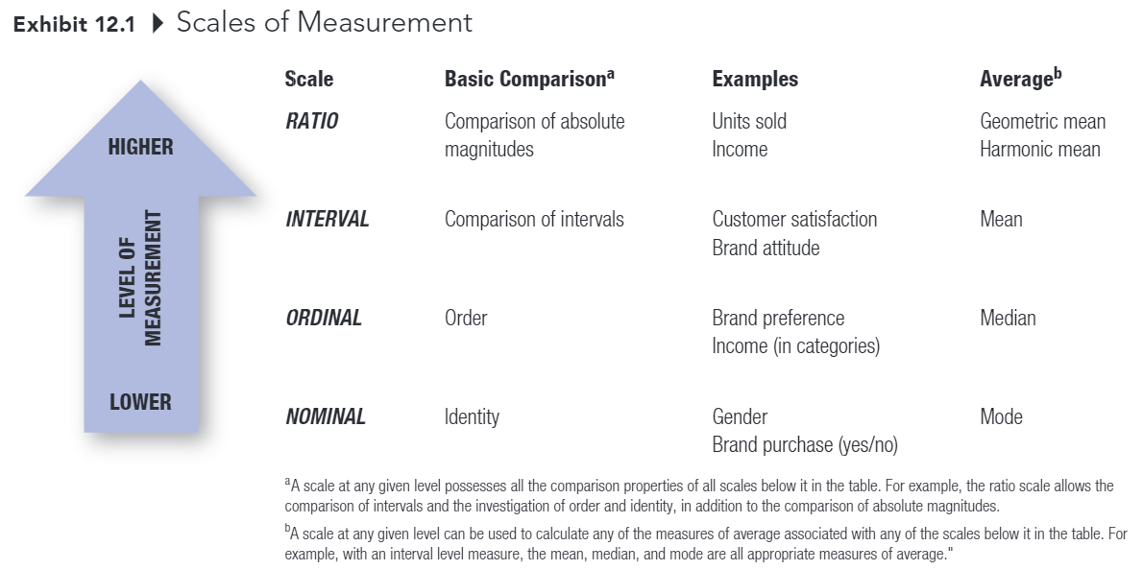
Measurement

Slide 13
Measurement
Higher levels of measurement have all the properties of lower levels of measurement
Nominal scale: measurement in which numbers are assigned to objects or classes of objects solely for the purpose of identification (e.g., which is your fav soft drinks? Coke, Dr. Pepper, etc.)
Ordinal scale; measurement in which numbers are assigned to data on the basis of some order (e.g., more than) of the objects (e.g., rank your fav drinks in descending order).

Slide 14
Measurement
Interval scale: measurement in which the assigned numbers legitimately allow the comparison of the size of the differences among and between members (e.g., Coke from extremely unfavorable … favorable).
Ratio scale; measurement that has a natural, or absolute, zero and there allows the comparison of absolute magnitudes of the numbers (e.g., how many ounces of Coke do you consume per day?)

Slide 15
Measuring Attitudes and Other Unobservable Concepts
Self-report: A method of assessing attitudes in which individuals are asked directly for their beliefs about or feelings toward an object of class of objects. (most common approach to measuring attitude)

Slide 16
Three General Types of Self-Report Attitude Scales
Itemized-Rating Scales
Graphic-Rating Scales
Comparative-Ratings Scales

Slide 17
Itemized-Rating Scales
A scale on which individuals must indicate their ratings of an attribute or object by selecting the response category that best describes their position on the attribute or object (e.g., Likert Summated-Rating Scales, Semantic Differential Scales)

Slide 18
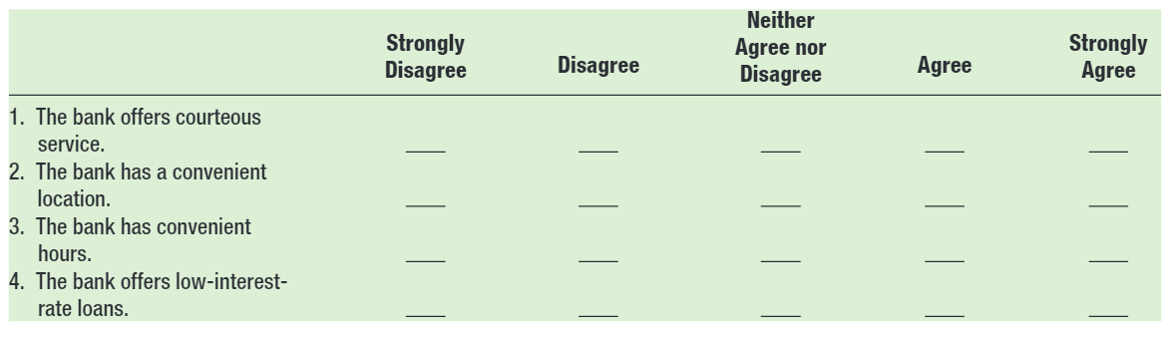
Summated-ratings Scale
A self-report technique for attitude measurement in which respondents indicate their degree of agreement or disagreement with each of a number of statements

Slide 19
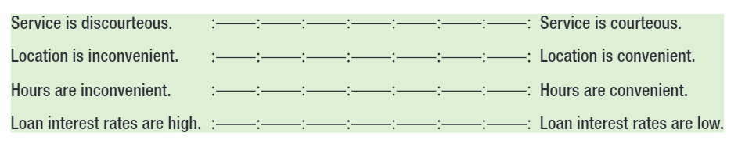
Semantic-differential Scale
A self-report technique for attitude measurement in which the subjects are asked to check which cell between a set of bipolar adjectives or phrases best describes their feelings toward the object.

Slide 20
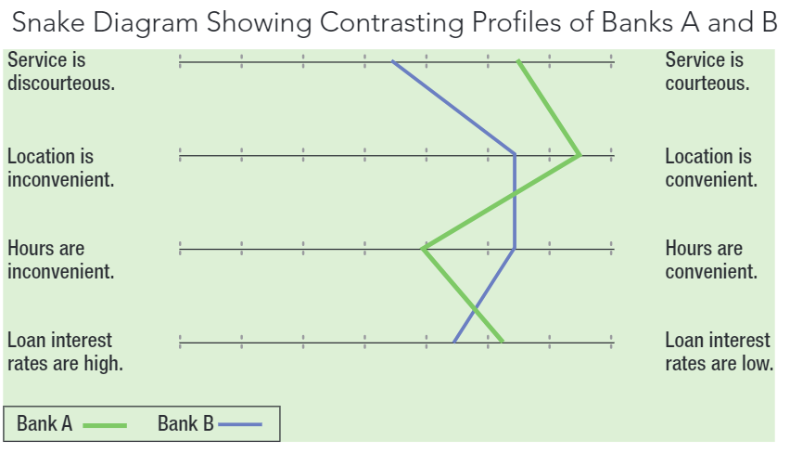

Slide 21
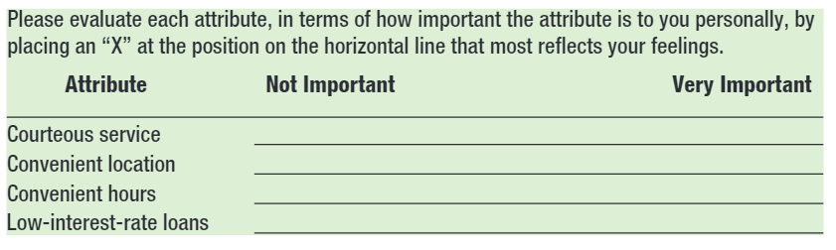
Graphic-Ratings Scales
A scale in which individuals indicate their ratings of an attribute typically by placing a check at the appropriate point on a line that runs from one extreme of the attribute to the other

Slide 22
Comparative-Rating Scales
A scale requiring subjects to make their ratings as a series of relative judgments or comparisons rather than as independent assessments.

Slide 23
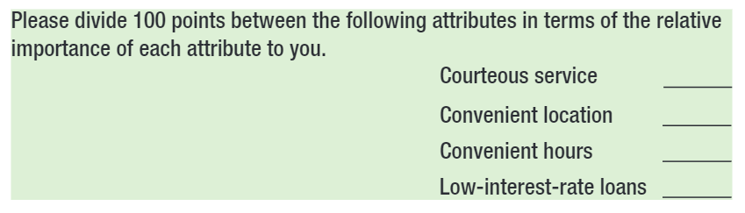
Constant-sum Method
A comparative-ratings scale in which an individual divides some given sum among two or more attributes on a basis such as importance or favorability

Slide 24
Other Considerations in Designing Scales
Number of items in a scale
Global measures versus composite measures
Number of scale positions
Odd or even number?
Including a “don’t know” or “not applicable” response category

Slide 25
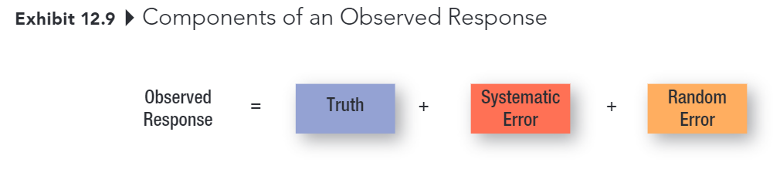
Establishing the Validity and Reliability of Measures

Slide 26
Error
Systematic Error
Error in measurement that is also known as constant error because it affects the measurement in a constant way
Random Error
Error in measurement due to temporary aspects of the person or measurement situation that affects the measurement in irregular ways.

Slide 27
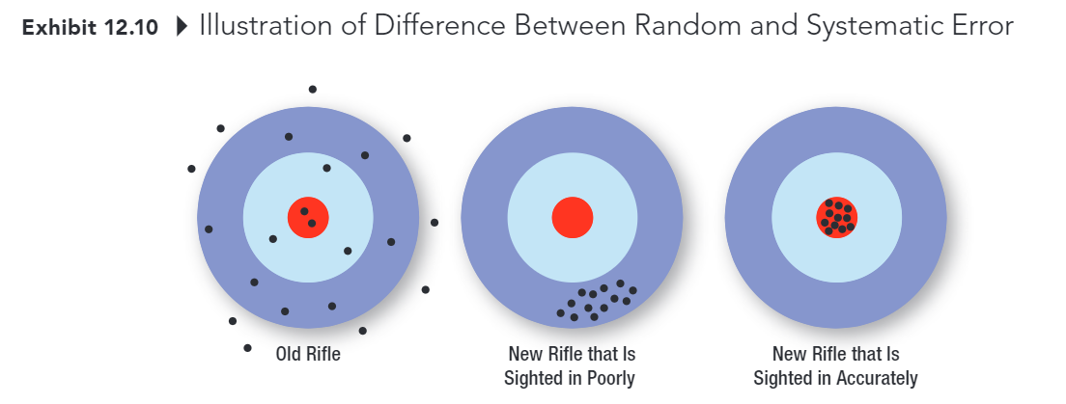
Difference between Random and Systematic Error

Slide 28
Reliability
Ability of a measure to obtain similar scores for the same object, trait, or construct across time, across different evaluators, or across the items forming the measure

Slide 29
Validity
The extent to which differences in scores on a measuring instrument reflect true differences among individuals, groups, or situations in the characteristics that it seeks to measure or true differences in the same individual, group, or situation from one occasion to another, rather than systematic or random errors.

Slide 30

Validity
Unreliable Not Valid
Reliable Not Valid
Reliable Valid
Notes:
A measure can be reliable but not valid
A valid measure must be reliable.

Slide 31
Recap Today Class

Slide 32
Qualtrics Homework
Did you read the instruction and start working on this homework?
Nah, I am chillin. It can wait. I think I can do it on Sunday.
I read it. But I have questions.
I read it, understood the instruction, and am working on it
I almost finish it.

Slide 33
5-min snippet

